Slide 1
BLOCKCHAIN & CRYPTOCURRENCY DURING COVID-19
FinTech BootCamp
Fintech Boot Camp
It will take years to transform business, but the journey begins now.- Marco Iansiti
Presented by: ShunZhou Tan(Jason Tan), Joyce Mbika, Sonali Goyal, Ghulam Mustafa Mundh
November 19, 2020

Slide 2


Slide 3
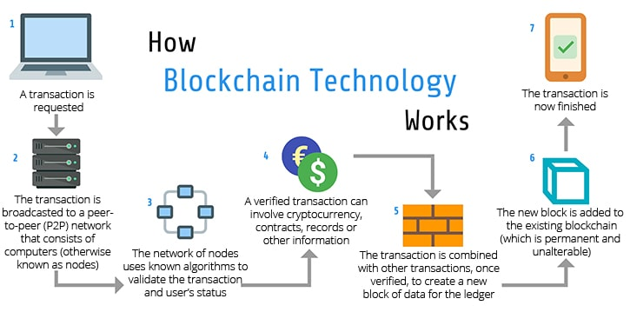
Block Chain
A blockchain is a decentralized, distributed, and oftentimes
public,digital ledger consisting of records called blocks that
is used to record transactions across many computers so
that any involved block cannot be altered retroactively,
without the alteration of all subsequent blocks.
Data stored on the blockchain is generally considered incorruptible.

Slide 4
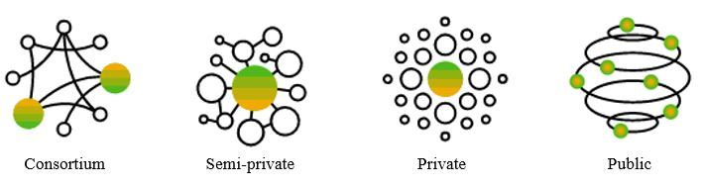
Types
Public blockchains
A public blockchain has absolutely no access restrictions. Anyone with an Internet connection can send transactions to it as well as become a validator (i.e., participate in the execution of a consensus protocol).[ Usually, such networks offer economic incentives for those who secure them and utilize some type of a Proof of Stake or Proof of Work algorithm.
Some of the largest, most known public blockchains are the bitcoin blockchain and the Ethereum blockchain.
Private blockchains
A private blockchain is permissioned.^{[40]} One cannot join it unless invited by the network administrators. Participant and validator access is restricted. To distinguish between open blockchains and other peer-to-peer decentralized database applications that are not open ad-hoc compute clusters, the terminology Distributed Ledger (DLT) is normally used for private blockchains.
Hybrid blockchains
A hybrid blockchain has a combination of centralized and decentralized features.^{[106]} The exact workings of the chain can vary based on which portions of centralization decentralization are used.
Consortium
A sidechain is a designation for a blockchain ledger that runs in parallel to a primary blockchain.^{[107][108]} Entries from the primary blockchain (where said entries typically represent digital assets) can be linked to and from the sidechain; this allows the sidechain to otherwise operate independently of the primary blockchain (e.g., by using an alternate means of record keeping, alternate consensus algorithm, etc.).^{[109]}

Slide 5
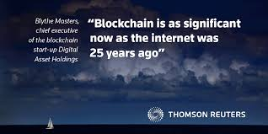
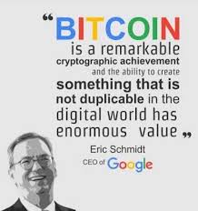

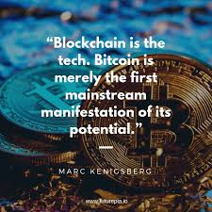

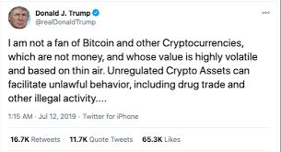
What are people saving about Bitcoin and Crypto?

Slide 6
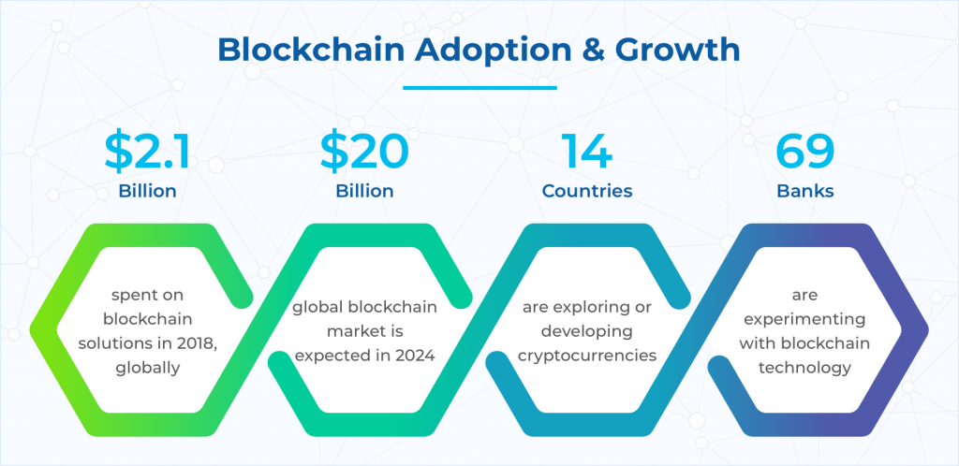
Growth in Block Chain
https://skeps.com/blog/emerging-trends-in-blockchain-technology

Slide 7
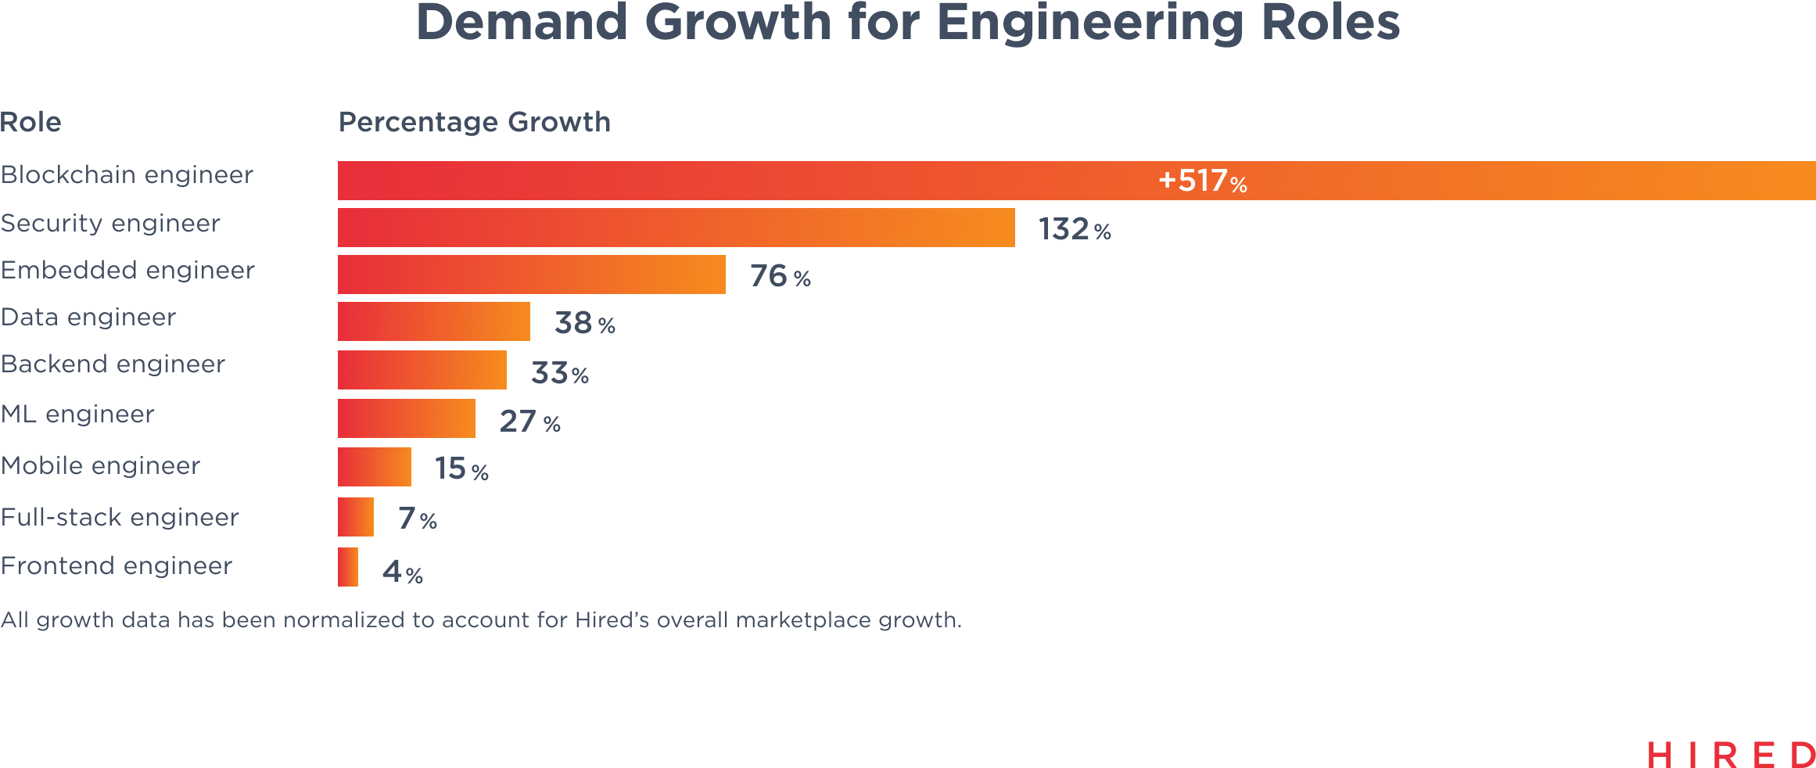
Want a job?

Slide 8
Impact of COVID-19 on Cryptocurrency

Slide 9

Data
https://coinmetrics.io/community-network-data/

Slide 10
Data Cleanup & Exploration

Slide 11
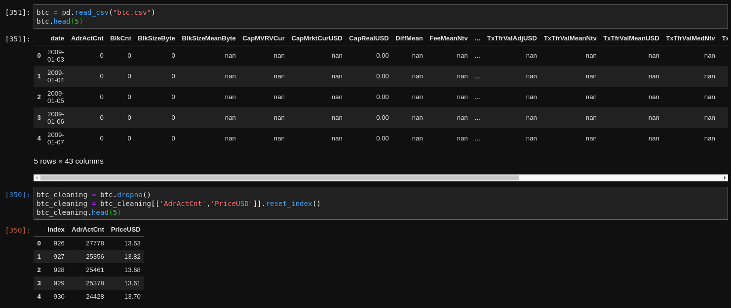
Data Cleanup process

Slide 12
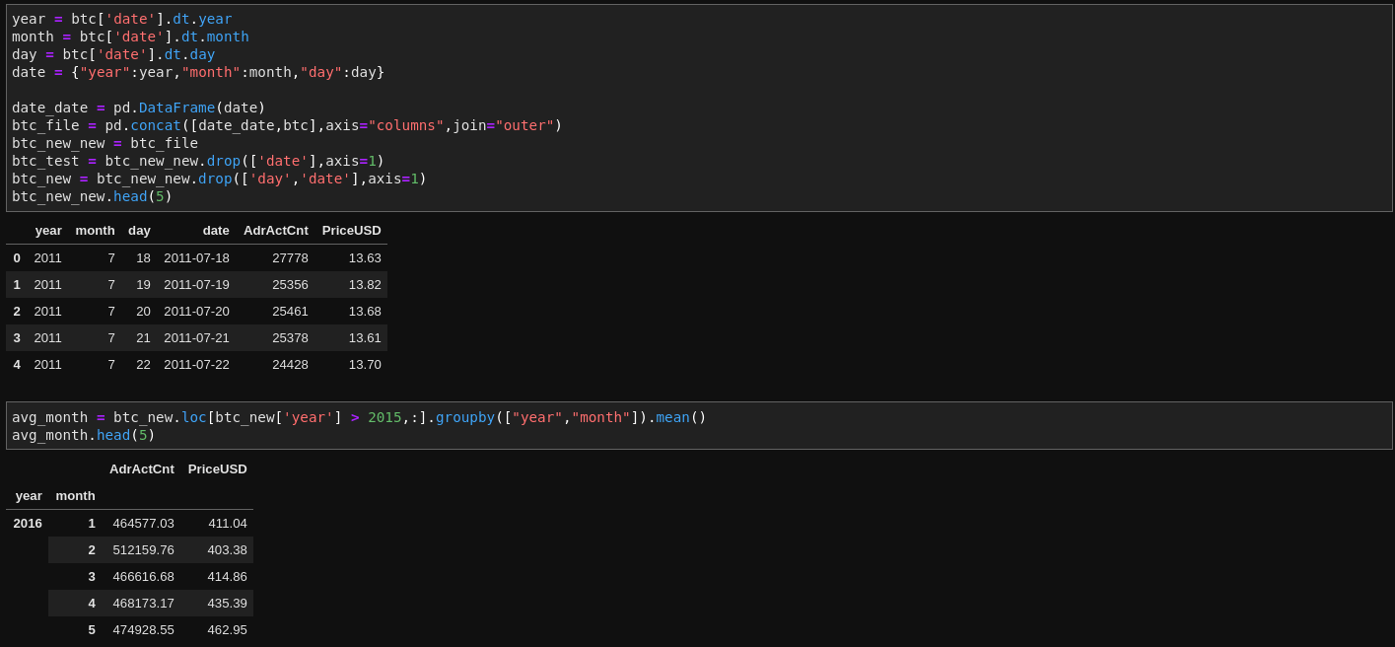
Data Cleaning Cont’d

Slide 13
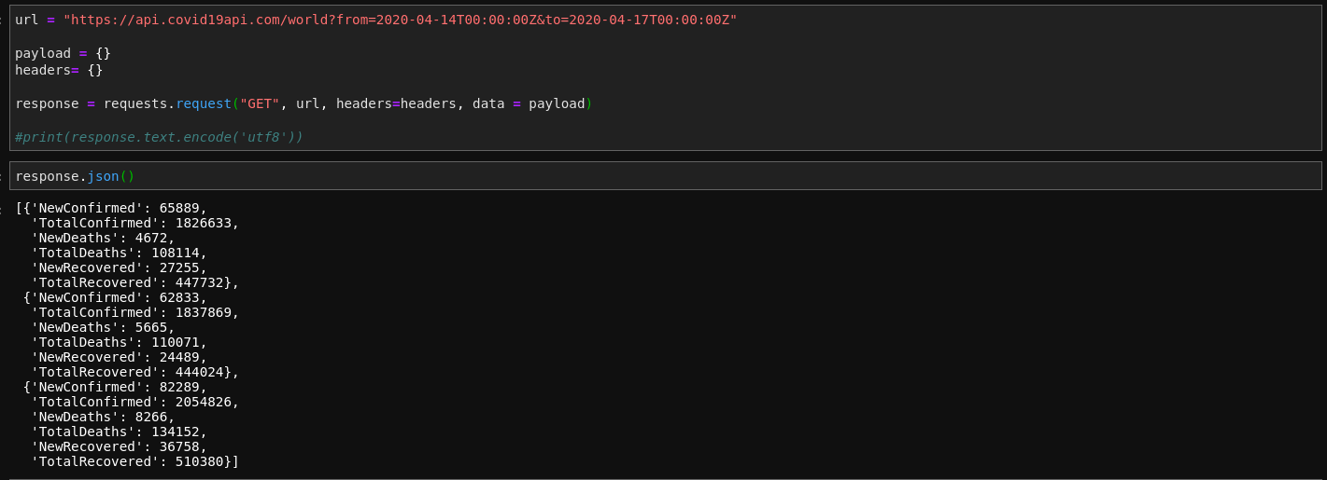
Covid Data Api

Slide 14
Data Analysis

Slide 15
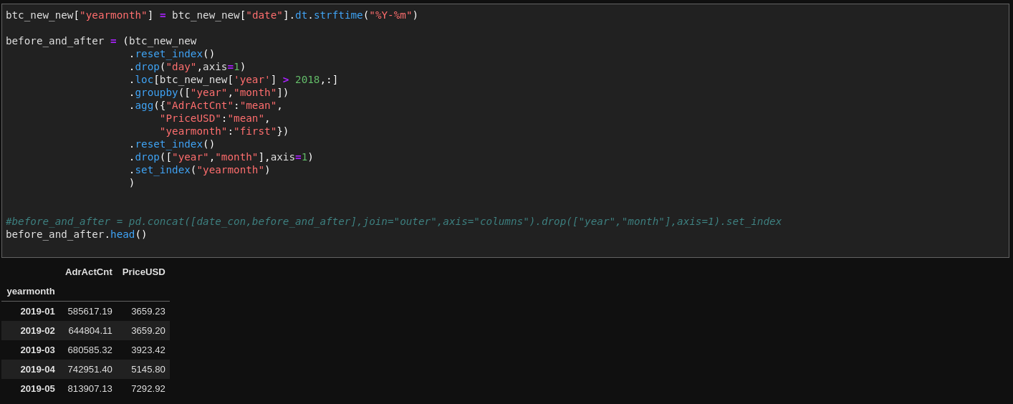
Steps Taken to Analyze Data

Slide 16
Findings

Slide 17
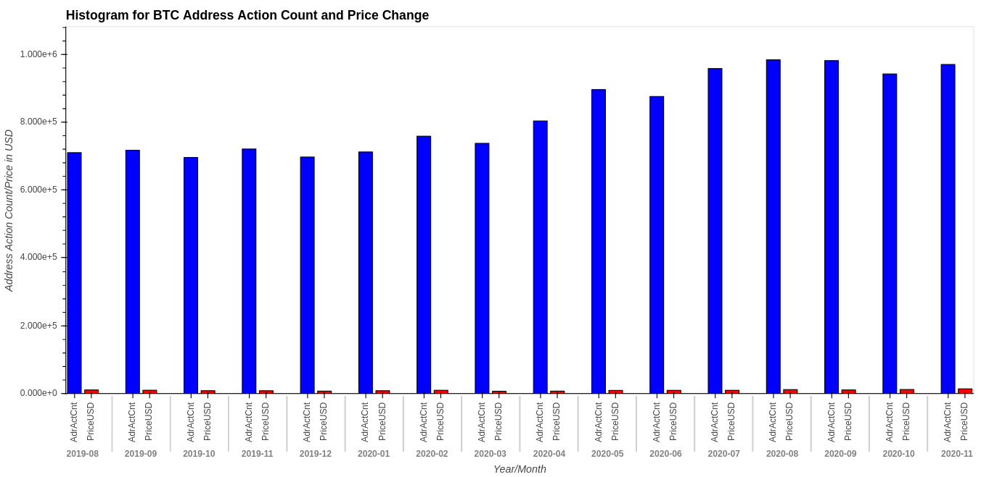
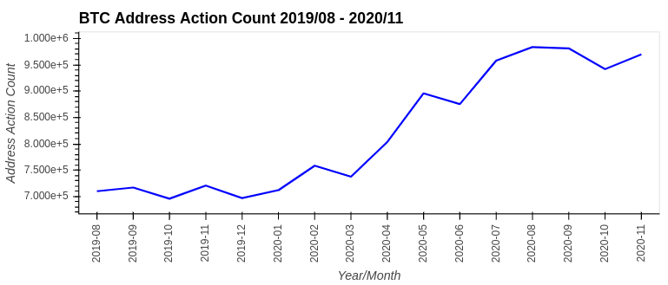
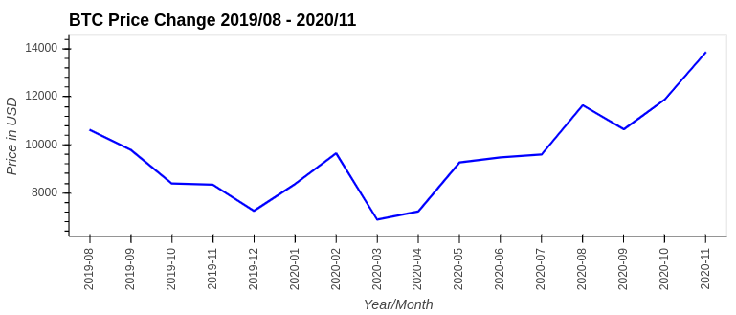
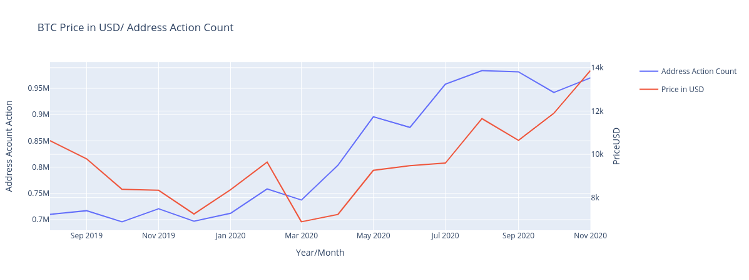
Figures Developed During Analysis
BTC
ETH
Both coins during COVID-19

Slide 18
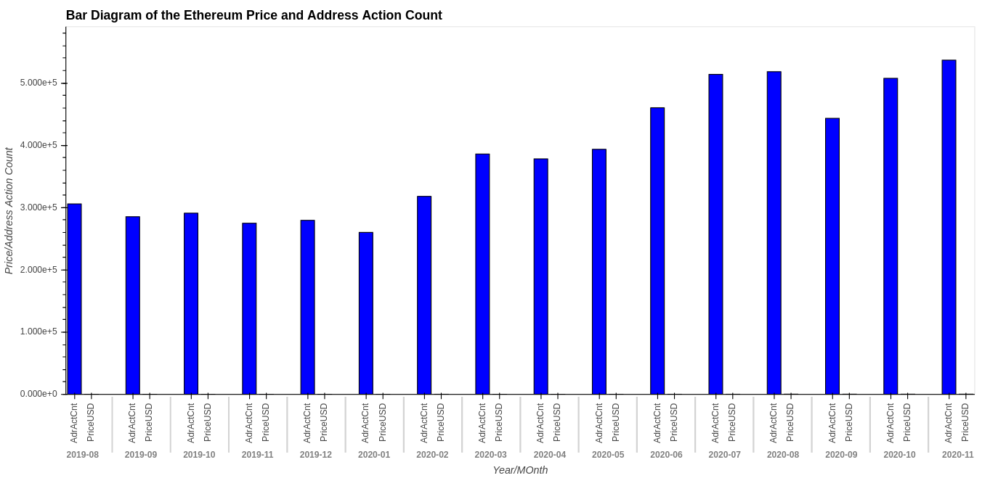
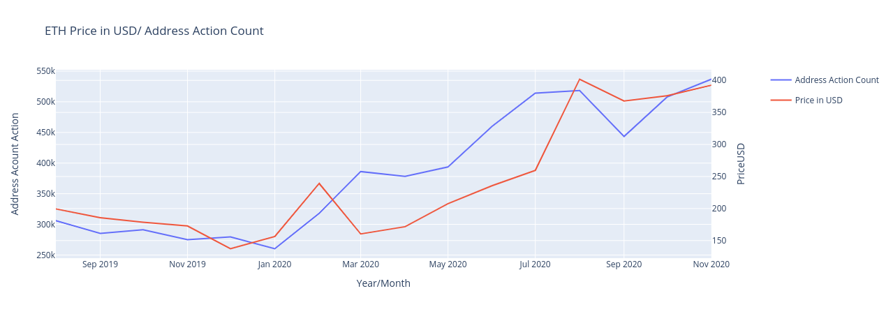
ETH

Slide 19
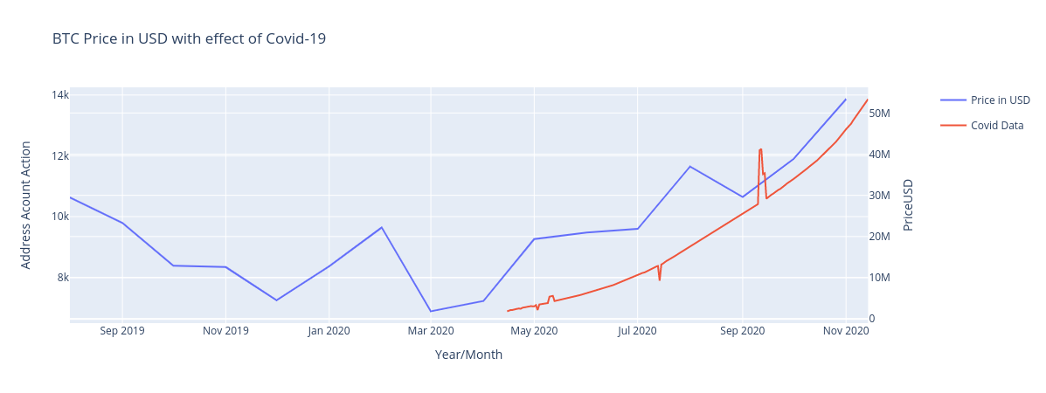
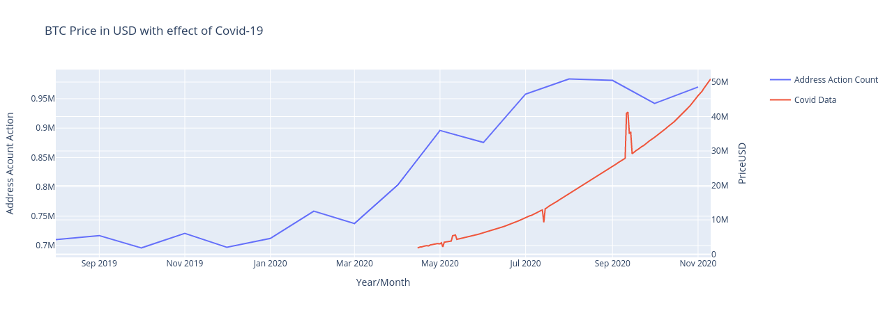
BTC with effects from COVID-19

Slide 20
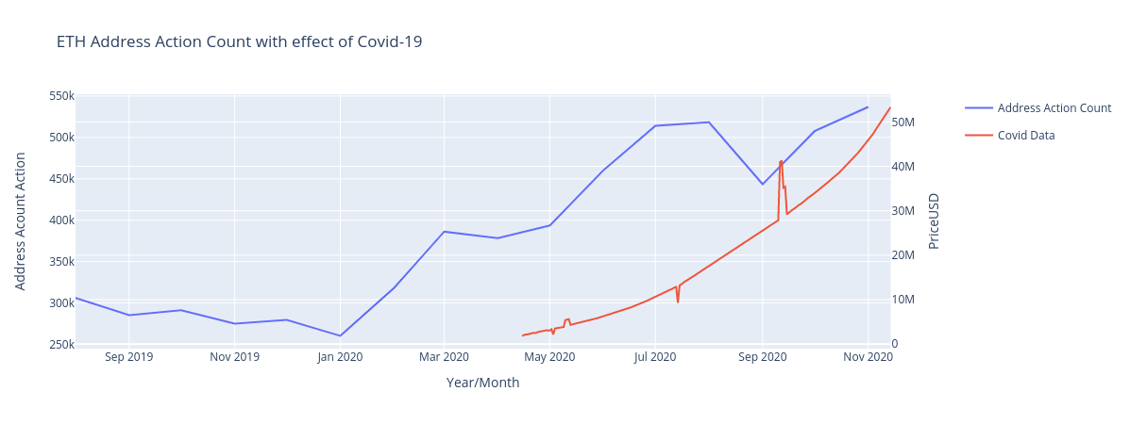
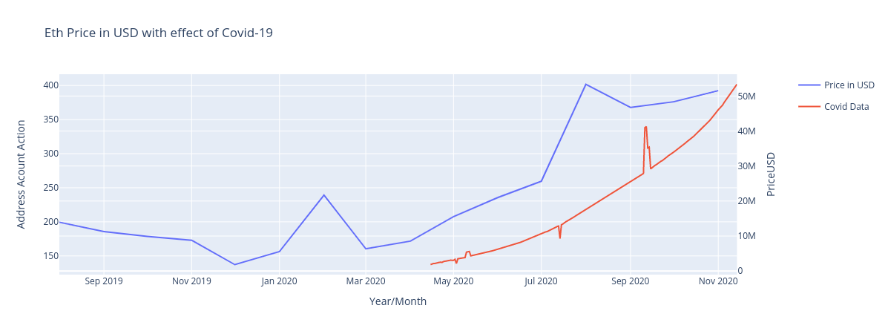
ETH with effects of COVID-19

Slide 21
Q&A

